Slide 1

European road network analysis
Project for the course of “Complessità nei sistemi e nelle reti”
Andrea Bertogalli
218342
Accademic year 2022/2023

Slide 2

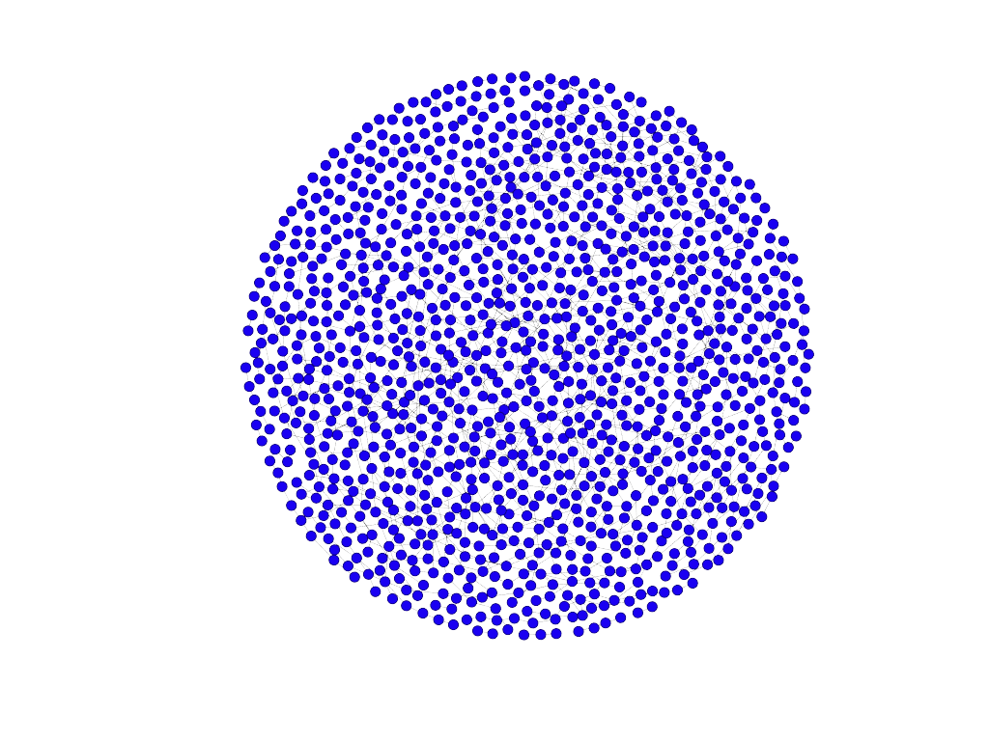
European road network analysis
Andrea Bertogalli, 218342
The dataset
The graph represents the European road network :
A node represents a city.
An edge represents a road directly connecting two cities.
There are 1174 nodes (cities), connected by 1417 edges (direct roads).
The network is undirected and unweighted.
Source: http://konect.cc/networks/subelj_euroroad/
Author: Lovro Šubelj (University of Ljubljana)
Related paper:
Robust network community detection using balanced propagation, L. Šubelj et. Al, 2011 (arxiv.org)
Fig.1: Fruchterman-Reingold layout plotted with Gephy.

Slide 3
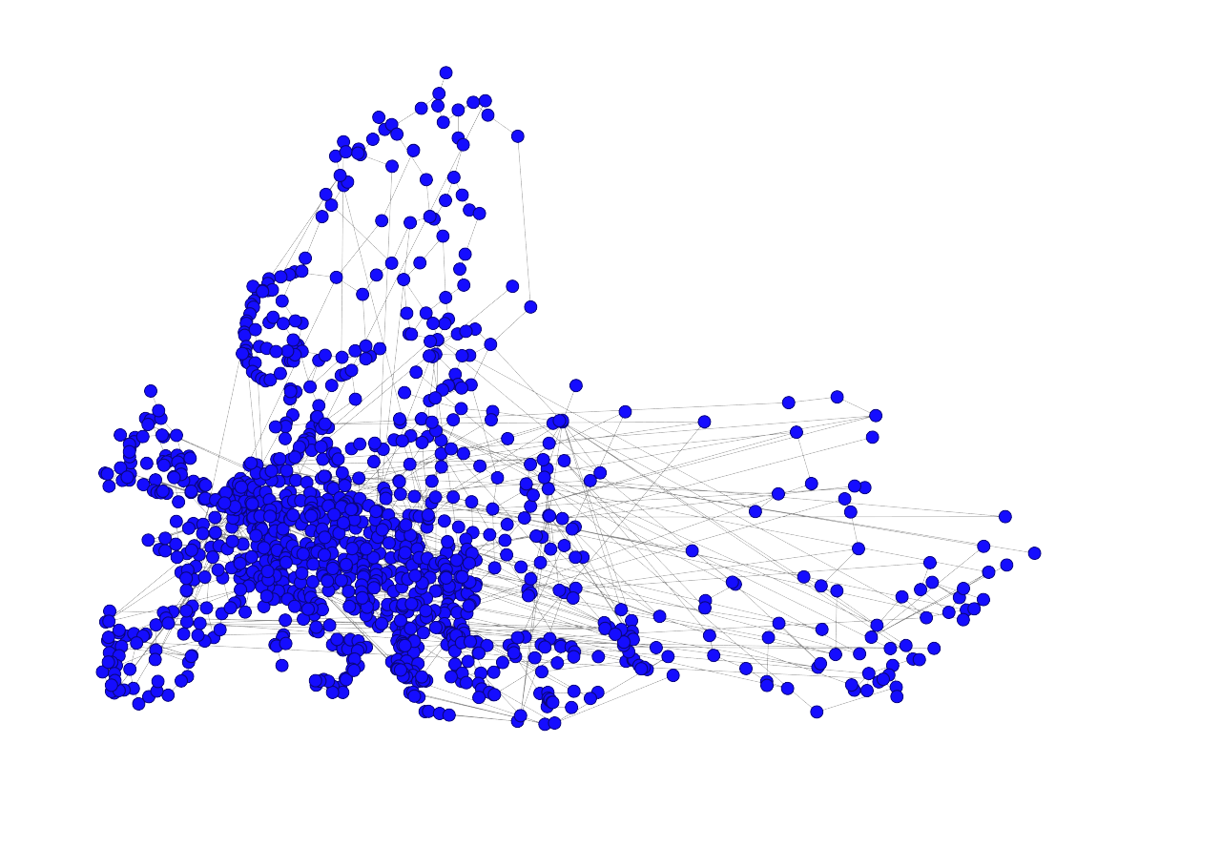
European road network analysis
Andrea Bertogalli, 218342
Pre-processing
Before starting to analyze the network, some pre-processing on the data is necessary in order to improve the visualization and, consequently, to facilitate further analysis.
We can automatically retrieve the latitude and the longitude of each city exploiting the nodes’ labels which correspond to the name.
Much better than the last slide…
Fig.2: GeoLayout plotted with Gephy.

Slide 4
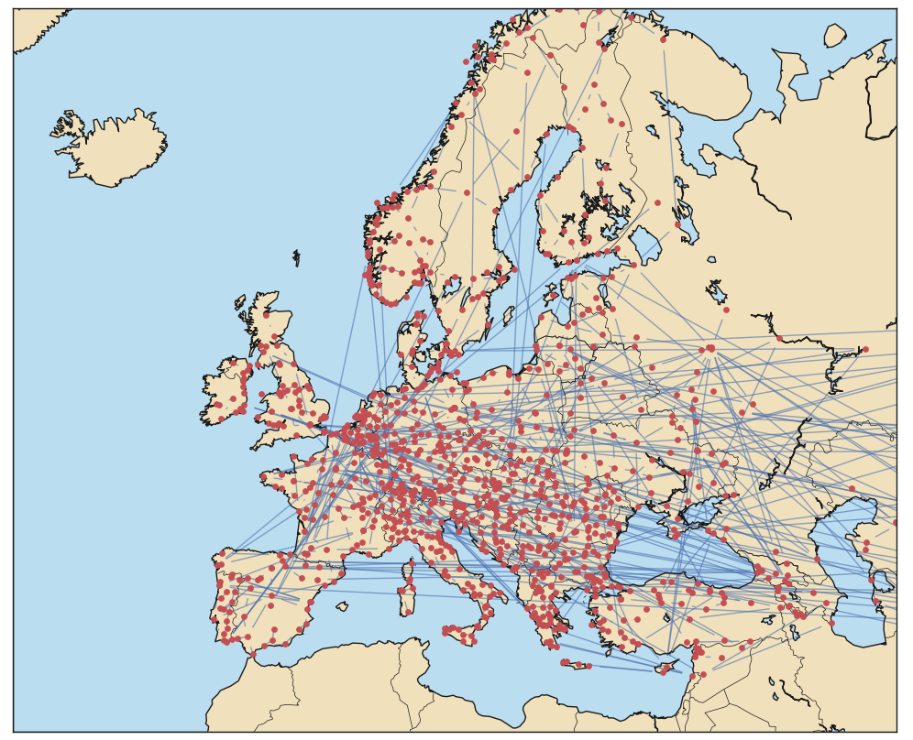
European road network analysis
Andrea Bertogalli, 218342
Pre-processing
We can also use a basemap to mark the Europe boundaries and see where the cities are located precisely.
Note that, due to the fact that coordinates are automatically retrieved, there may be some nodes drawn in the wrong position, but it’s just a graphical matter.
Fig.3: NetworkX graph plotted on a basemap using matplotlib.

Slide 5
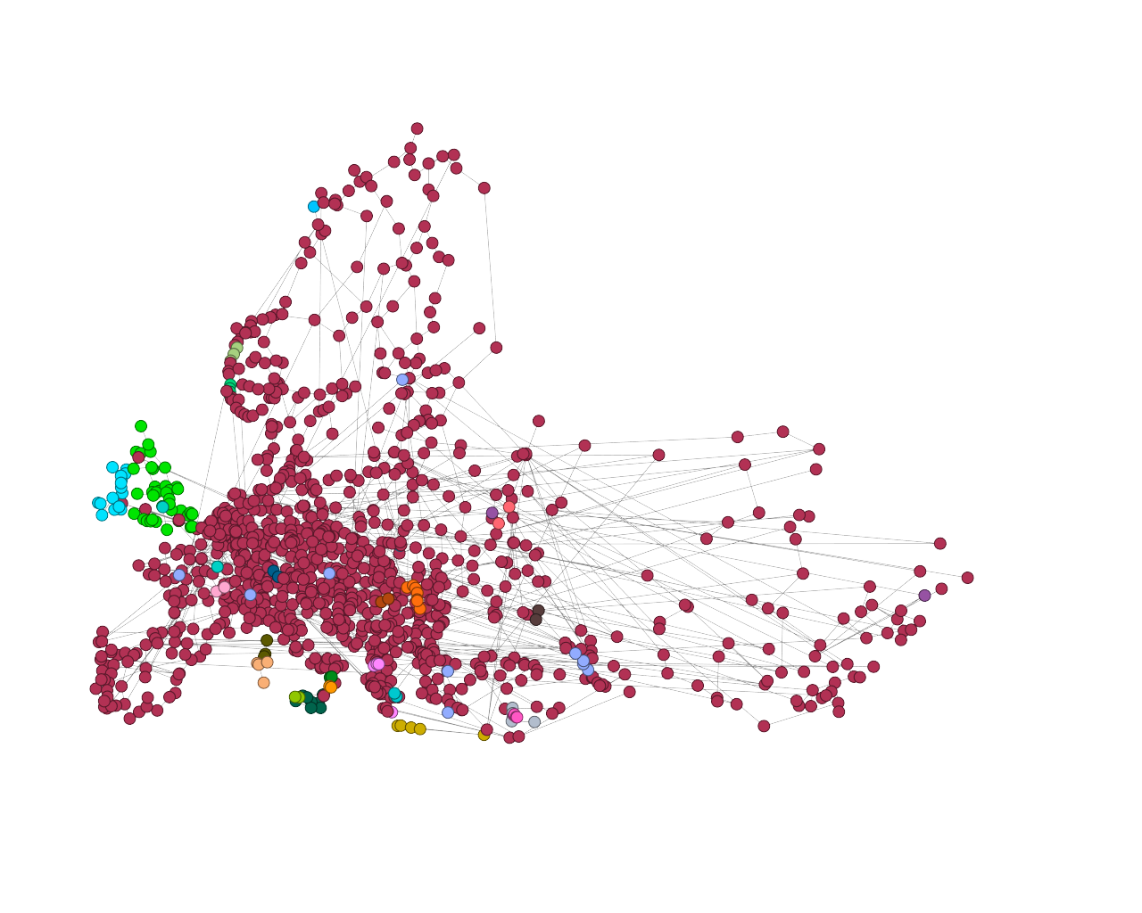
European road network analysis
Andrea Bertogalli, 218342
Network properties
By analyzing the network, it can be seen that there are multiple connected components (26) but only one of them is relevant, so only the latter has been analyzed.
The giant component has 1305 edges and 1039 nodes.
Fig.4: The network’s components plotted with Gephy (dark red = giant component).

Slide 6
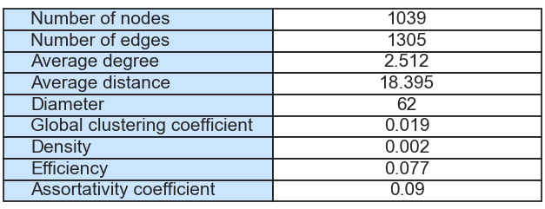
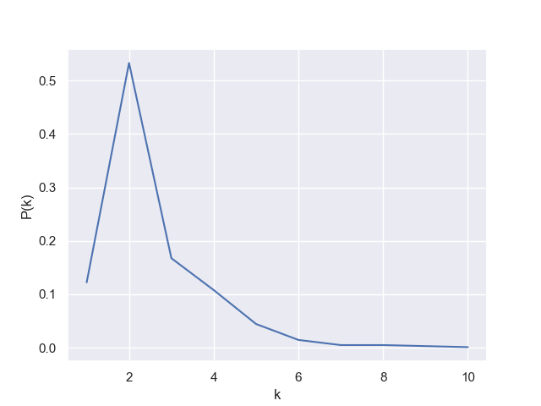
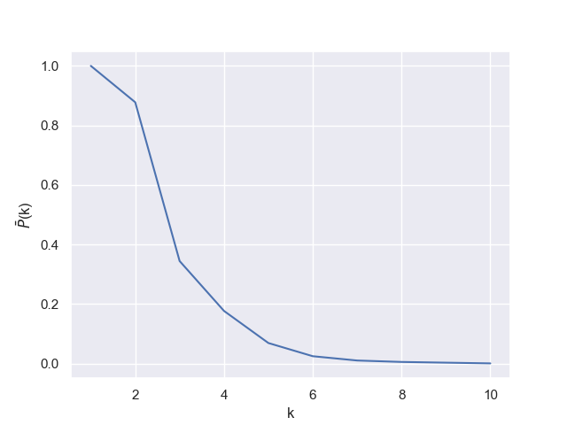
European road network analysis
Andrea Bertogalli, 218342
Network properties
Considering the average distance (≈18) and the degree distribution we can state that the network is neither small word nor scale-free, moreover the network has almost tree-like structure and it’s very sparse.
Fig.5: Some properties of the network.
Fig.6: The degree distribution of the network.
Fig.7: The cumulated degree distribution of the network.

Slide 7
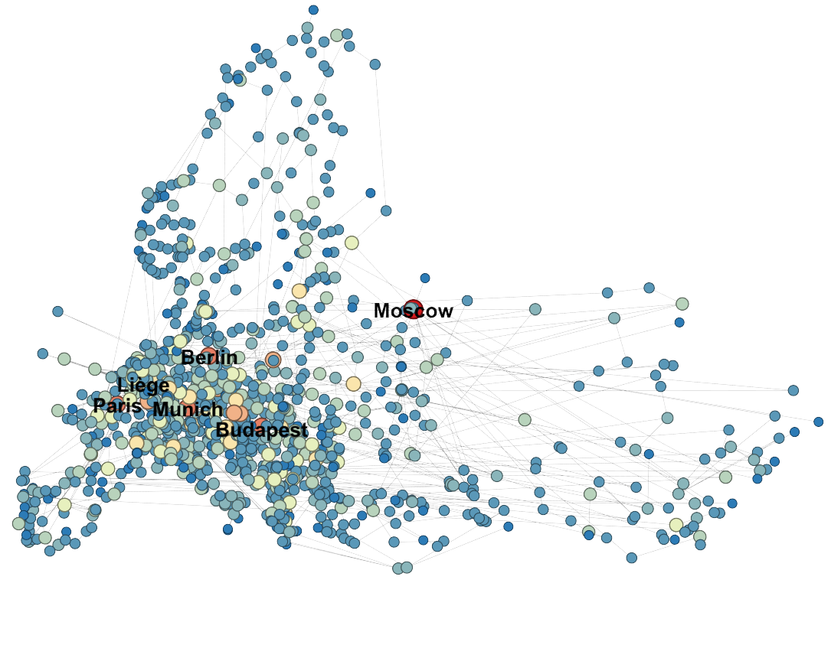
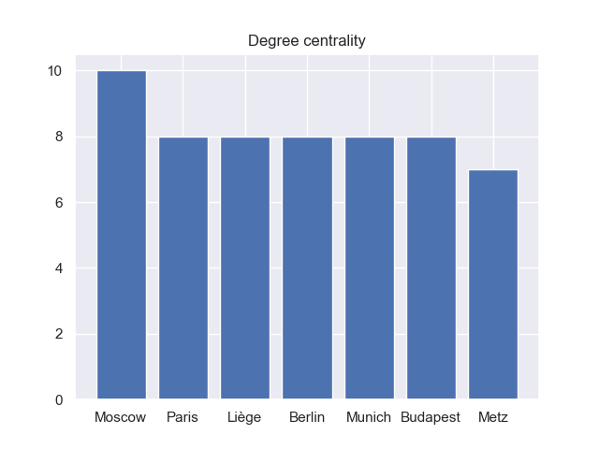
European road network analysis
Andrea Bertogalli, 218342
Centralities - Degree
Fig.8: Top 7 for degree.
Fig.9: Degree centrality plotted with Gephy, red means high degree

Slide 8
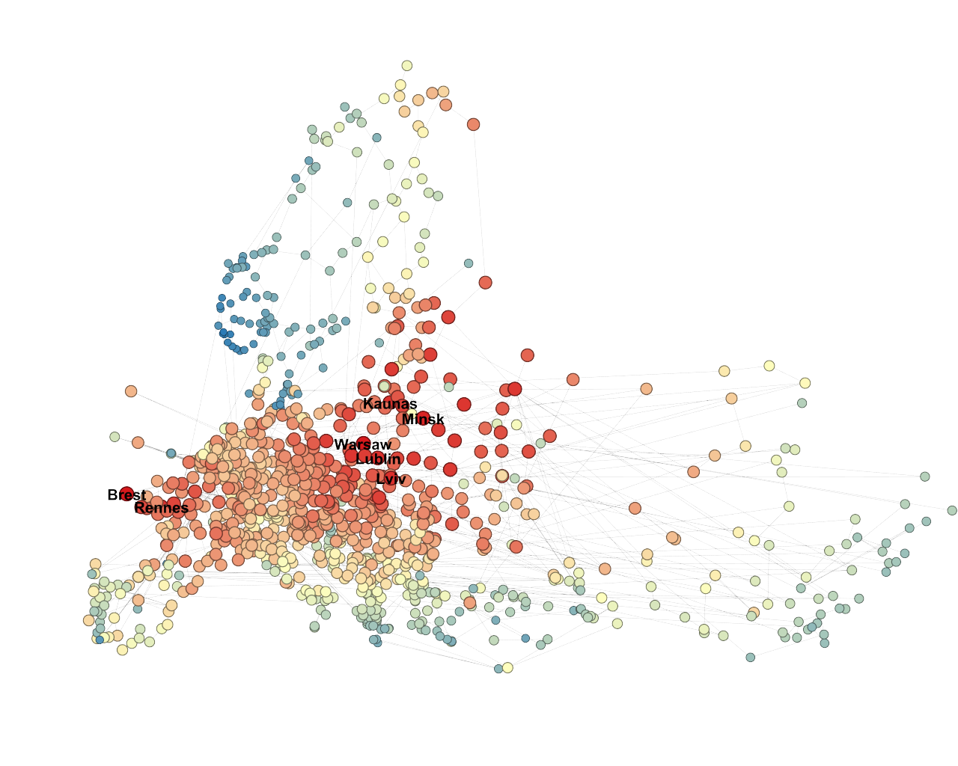
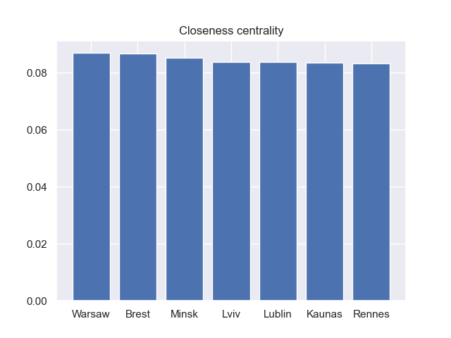
European road network analysis
Andrea Bertogalli, 218342
Centralities - Closeness
Fig.10: Top 7 for closeness centrality score.
Fig.11: Closeness centrality score plotted with Gephy, rec
means high closeness score.

Slide 9
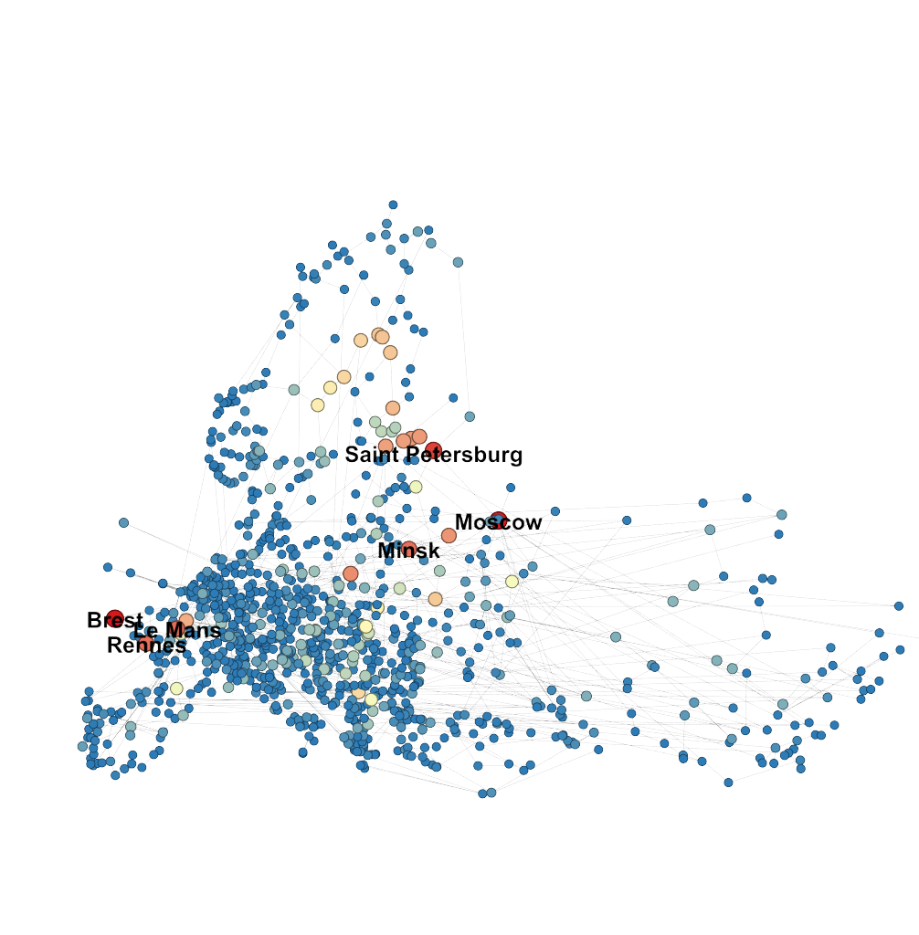
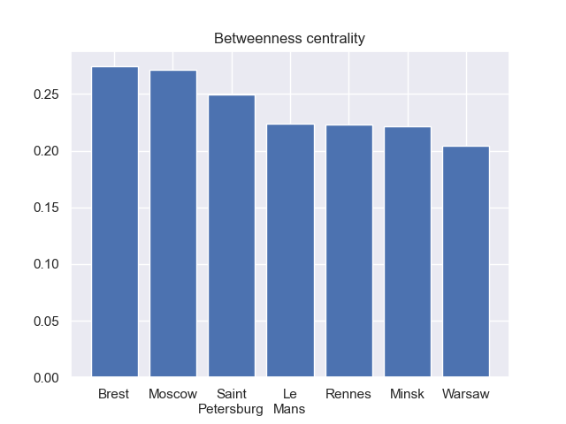
European road network analysis
Andrea Bertogalli, 218342
Centralities - Betweenness
Fig.12: Top 7 for betweenness centrality score.
Fig.13: Betweenness centrality score plotted with Gephy, red
means high betweenness score

Slide 10
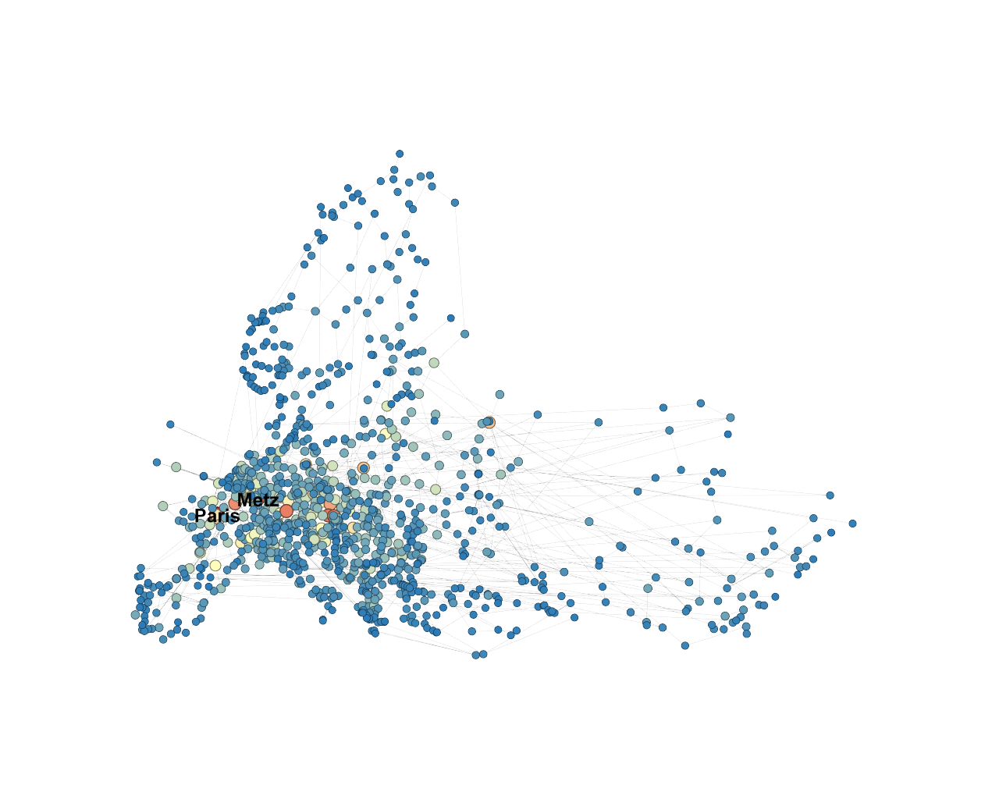
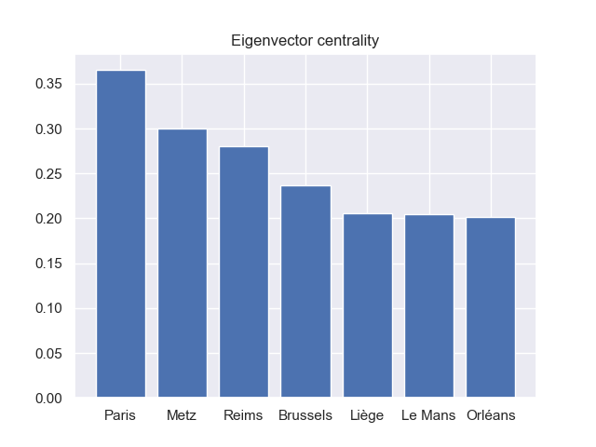
European road network analysis
Andrea Bertogalli, 218342
Centralities - Eigenvector
Fig.14: Top 7 for eigenvector centrality score.
Fig.15: Eigenvector centrality score plotted with Gephy, red
means high eigenvector score

Slide 11
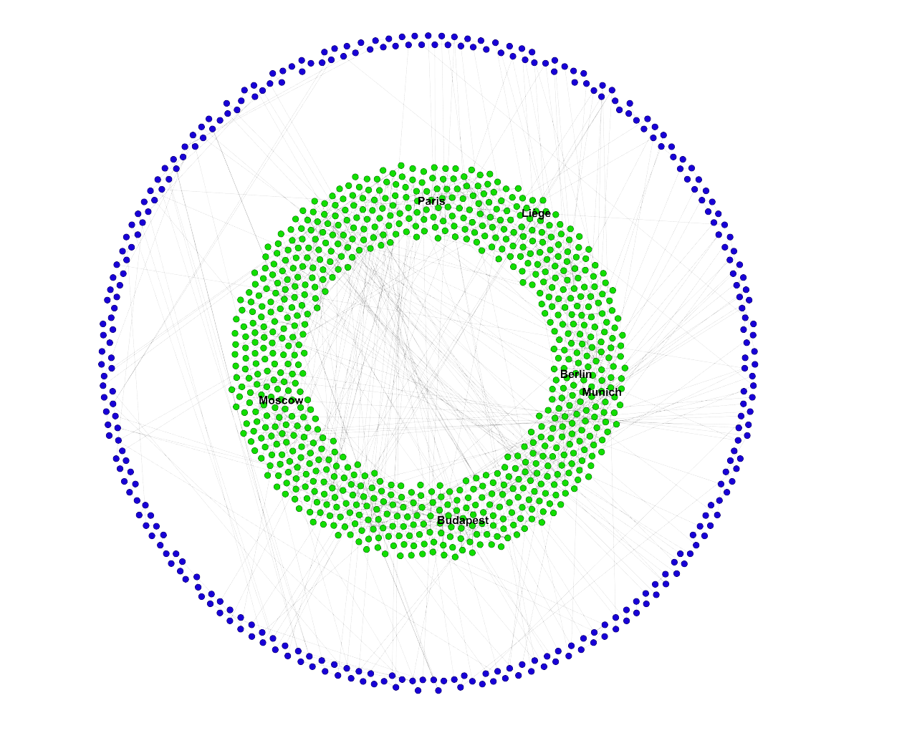
European road network analysis
Andrea Bertogalli, 218342
Core-Periphery analysis
By applying the decomposition algorithm we notice that the network consists of only two shells. This binary division allows us to distinguish a periphery (1-Shell), composed by 303 nodes, and a core (2-Shell), composed by 736 nodes.
In the figure the blue nodes represent the 1-Shell while the green one the 2-Shell.
K = 2
K = 1
Fig.16: K-Core decomposition computed with networkX and plotted with Gephy (Dual Circle Layout).

Slide 12
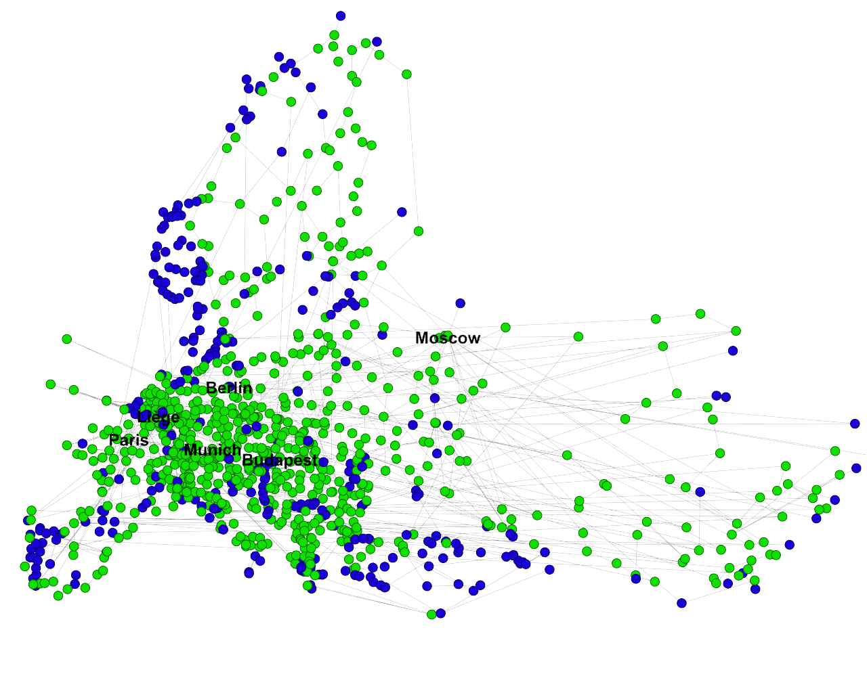
European road network analysis
Andrea Bertogalli, 218342
Core-Periphery analysis
It’s interesting to note that the periphery coincides fairly well with the geographic periphery of Europe, this highlights that the European road network is more sparse in the periphery while more dense in the core.
Fig.17: K-Core decomposition computed with networkX and plotted with Gephy.

Slide 13
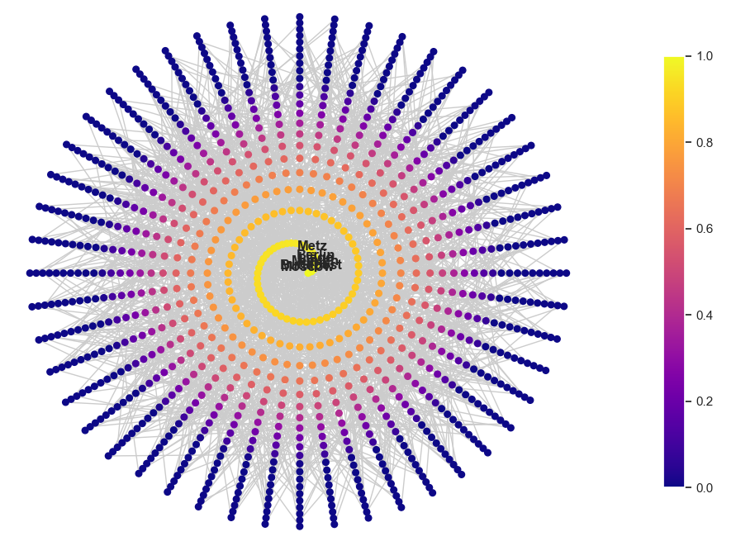
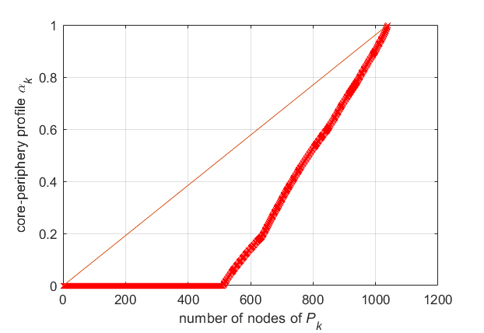
European road network analysis
Andrea Bertogalli, 218342
Core-Periphery analysis
We can also consider the core-periphery profile of the network to highlight an ordering of nodes from the periphery to the core.
Reference:
Profiling core-periphery network structure by random walkers, F. Della Rossa et al, 2013.
(nature.com)
Fig.18: Core-periphery profile ordered nodes, custom layout NetworkX.

Slide 14
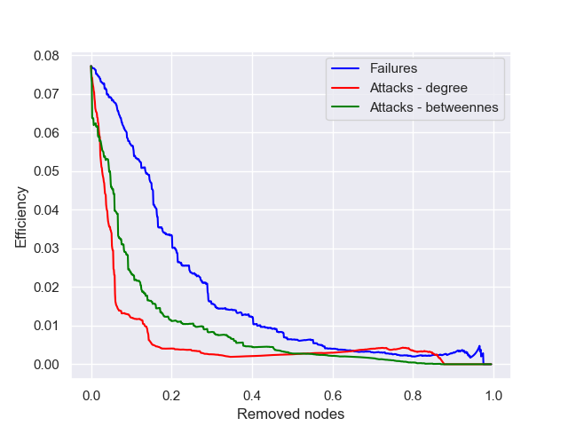
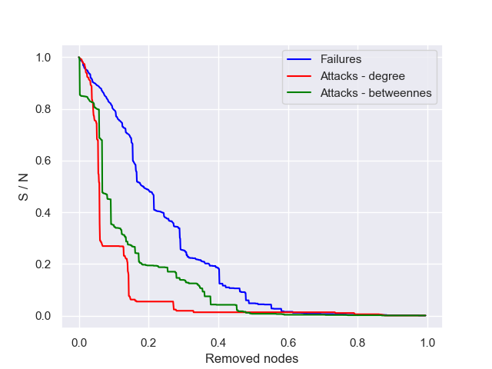
European road network analysis
Andrea Bertogalli, 218342
Robustness analysis
To analyze the robustness of the network, both attacks and failures were simulated. The robustness evaluation is made by considering the efficiency (E) and the ratio of the largest connected component to the entire network (S/N).
Fig.19: Attacks and failures simulation.

Slide 15
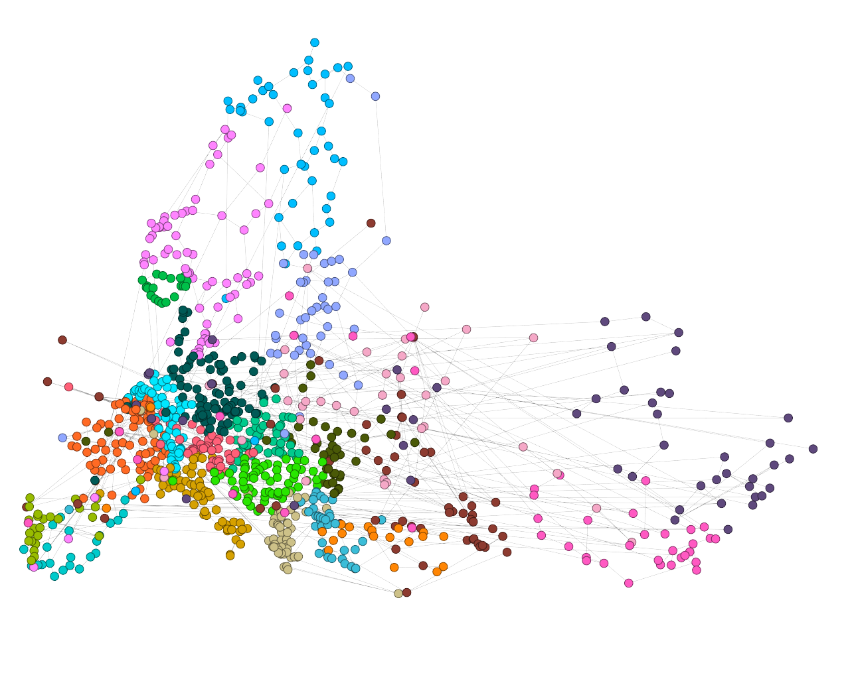
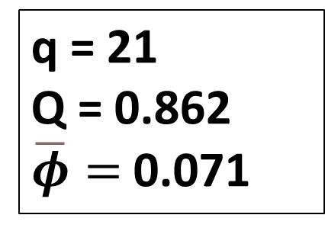
European road network analysis
Andrea Bertogalli, 218342
Community detection - Louvain
Analyzing the network from a community perspective revealed that the network has a strong community structure.
By using the Louvain method 21 communities are found, with a corresponding modularity score of 0.862.
We also note that (especially in the central
Europe) the communities correspond quite
well with countries.
Reference:
Fast unfolding of communities in large
networks, Blondel et al. 2008.
(arxiv.org).
q = 21
Q = 0.862
$\overline{φ}=$0.071
Fig.20: Community detection using the Louvain method, plotted eith gephy.

Slide 16
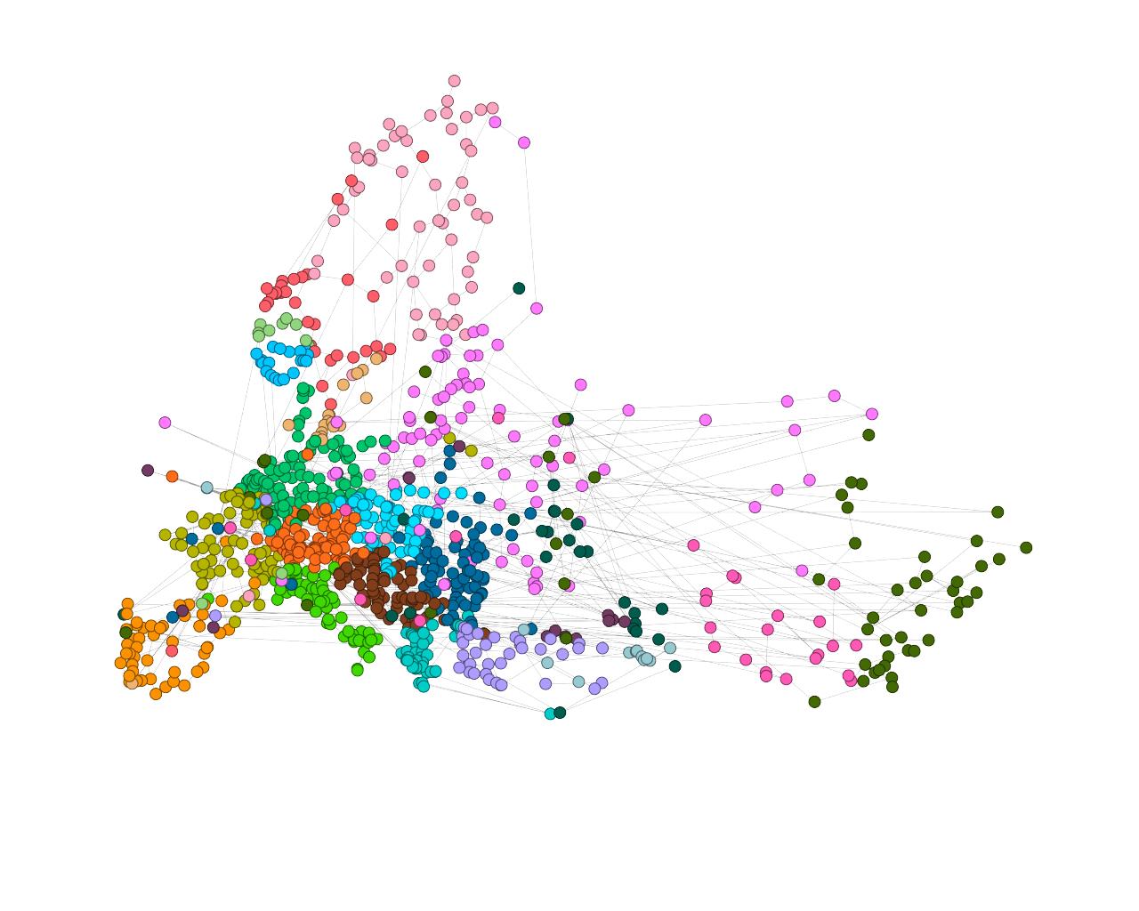
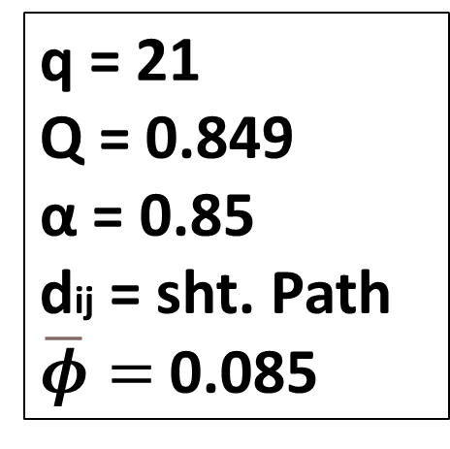
European road network analysis
Andrea Bertogalli, 218342
Community detection – Persistence probabilities
An alternative method to reveal the network’s community structure is by using the persistence probabilities.
Increasingly granular partitions are generated using (divisive) hierarchical clustering (using Floyd-Warshall to generate the distance matrix), then the partitions are evaluated by means of a persistence probability threshold (α), finally, the more granular partition is taken.
Reference:
Finding and testing network communities by lumped Markov chains, C. Piccardi, 2011.
(arxiv.org).
q = 21
Q = 0.849
α = 0.85
dij = sht. Path
$\overline{φ}=$0.085
Fig.21: Community detection using the α-community & α-partition method.

Slide 17
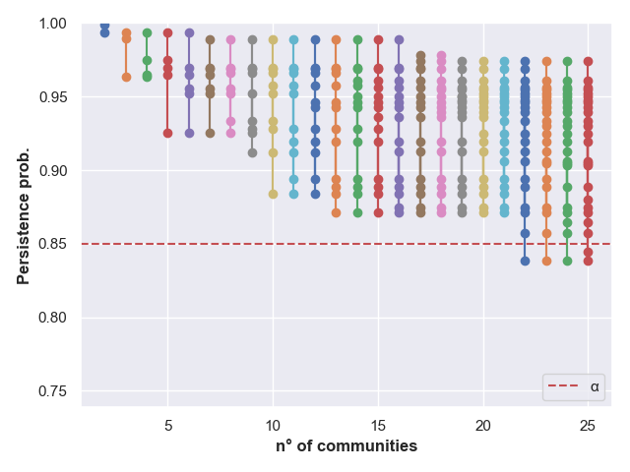
European road network analysis
Andrea Bertogalli, 218342
Community detection – Persistence probabilities
From the plot we can notice that the “last” partition, which is composed by communities above the dashed line, is the one with 21 communities.
Other tests can be done by varying alpha and by changing the distance used for the clustering.
Reference:
Finding and testing network communities by lumped Markov chains, C. Piccardi, 2011.
(arxiv.org).
Best partition
Fig.22: α-partitions method plot, NetworkX.

Slide 18
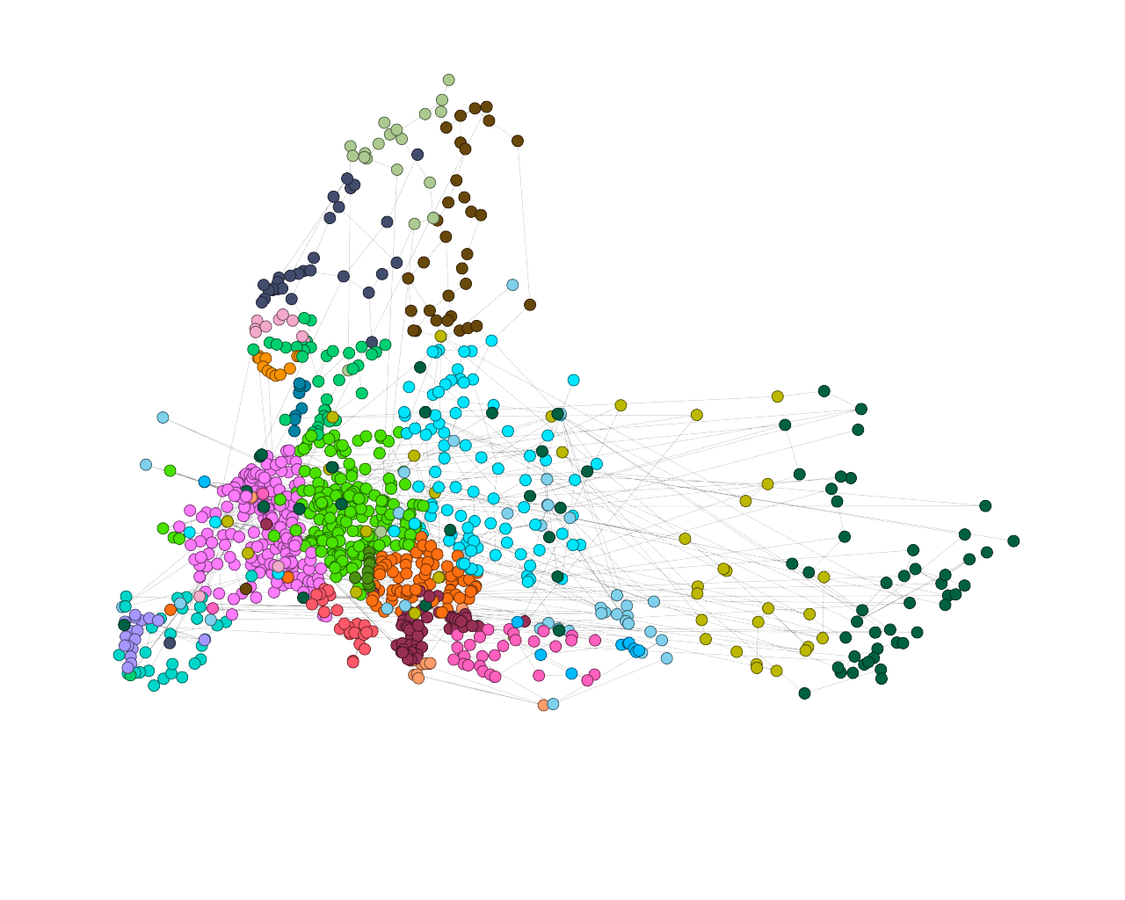
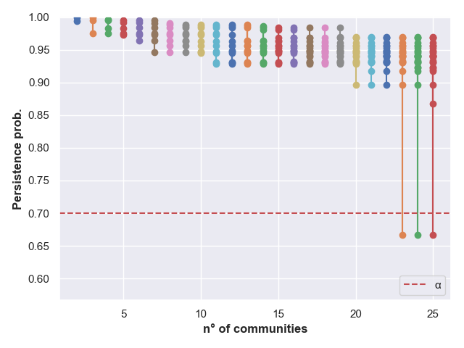
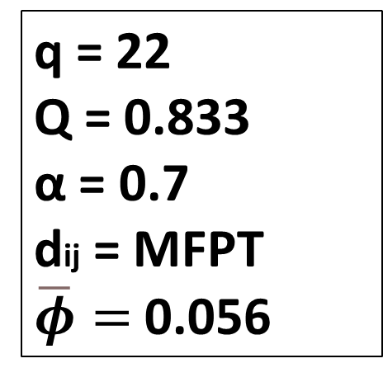
European road network analysis
Andrea Bertogalli, 218342
Community detection – Persistence probabilities
Reference:
Finding and testing network communities by lumped Markov chains, C. Piccardi, 2011.
(arxiv.org).
q = 22
Q = 0.833
α = 0.7
dij = MFPT
$\overline{φ}=$0.056
Best partition
Fig.23: Community detection using the α-community & α-partition method.

Slide 19
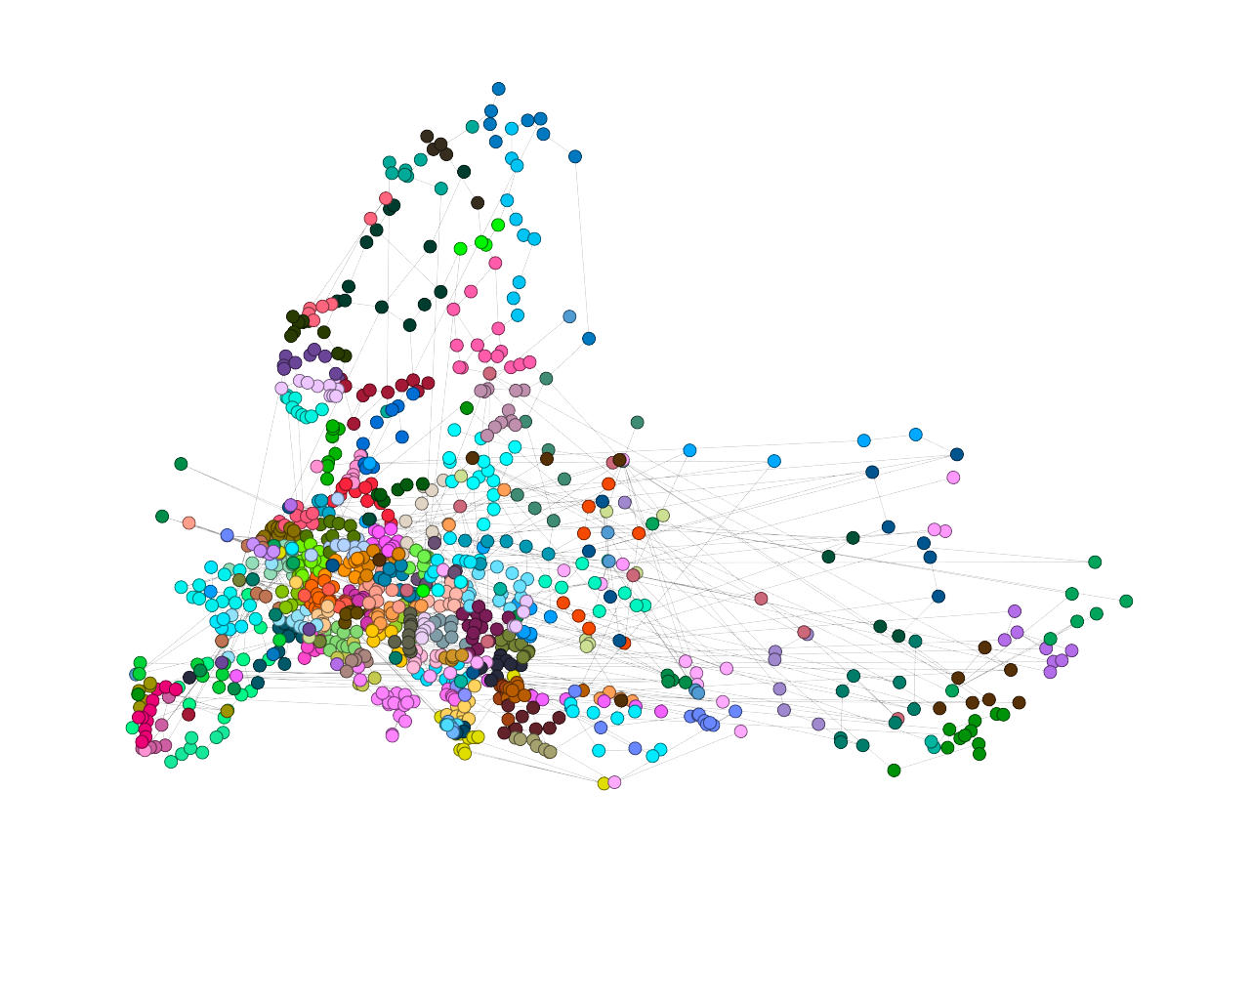
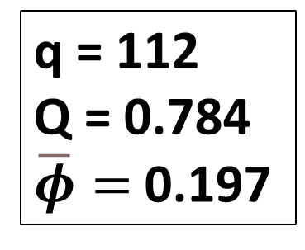
European road network analysis
Andrea Bertogalli, 218342
Community detection – Infomap
By applying Infomap we obtain a finer division between communities, in fact 112 communities are highlighted by the algorithm.
In this case we can distinguish some relevant regions, for example Italy seems to be divided in 3 main parts (north, center, south).
Reference:
Maps of random walks on complex networks reveal community structure, M. Rosvall, C. T. Bergstrom, 2008. (arxiv.org)
q = 112
Q = 0.784
$\overline{φ}=$0.197
Fig.24: Infomap partition plot, plotted with Gephy.

Slide 20
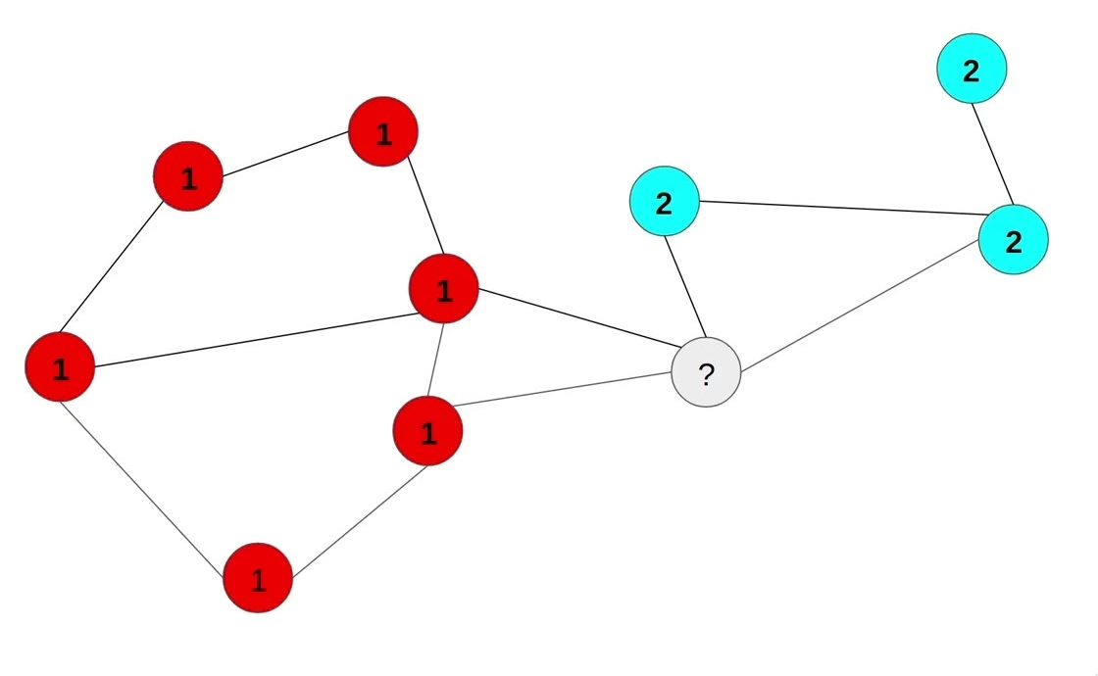
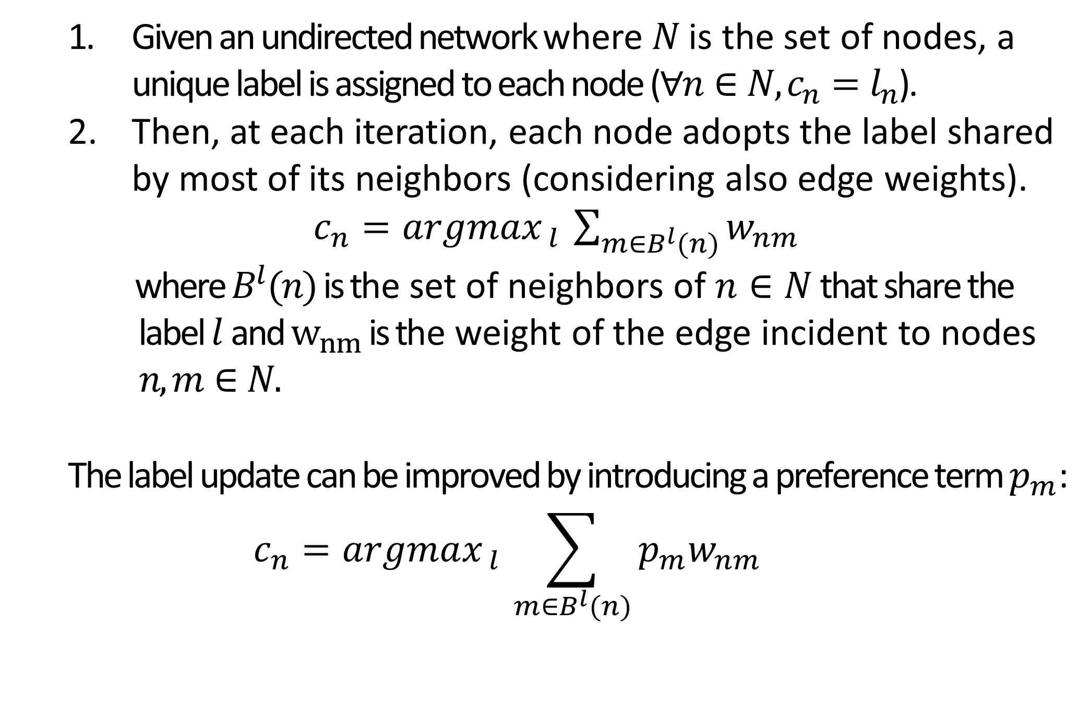
European road network analysis
Andrea Bertogalli, 218342
Community detection – LPA
Given an undirected network where $N$ is the set of nodes, a unique label is assigned to each node ($∀n∈N, c_{n}=l_{n}$).
Then, at each iteration, each node adopts the label shared by most of its neighbors (considering also edge weights).
$c_{n}=argmax_{ l }\sum_{m∈B^{l}(n)}{w_{nm}}$
where $B^{l}(n)$ is the set of neighbors of $n∈N$ that share the label $l$ and $w_{nm}$ is the weight of the edge incident to nodes $n,m∈N.$
The label update can be improved by introducing a preference term $p_{m}$:
$$c_{n}=argmax_{ l }\sum_{m∈B^{l}(n)}{{p_{m}w}_{nm}}$$
Fig.25: LPA for community detection.
Reference:
Near linear time algorithm to detect community structures in large-scale networks, U. N. Raghavan et al., 2007. (arxiv.org) [LPA]
Reference:
Towards real-time community detection in large networks, I. X. Y Leung et al., 2009. (arxiv.org)
[LPA with preferences]

Slide 21
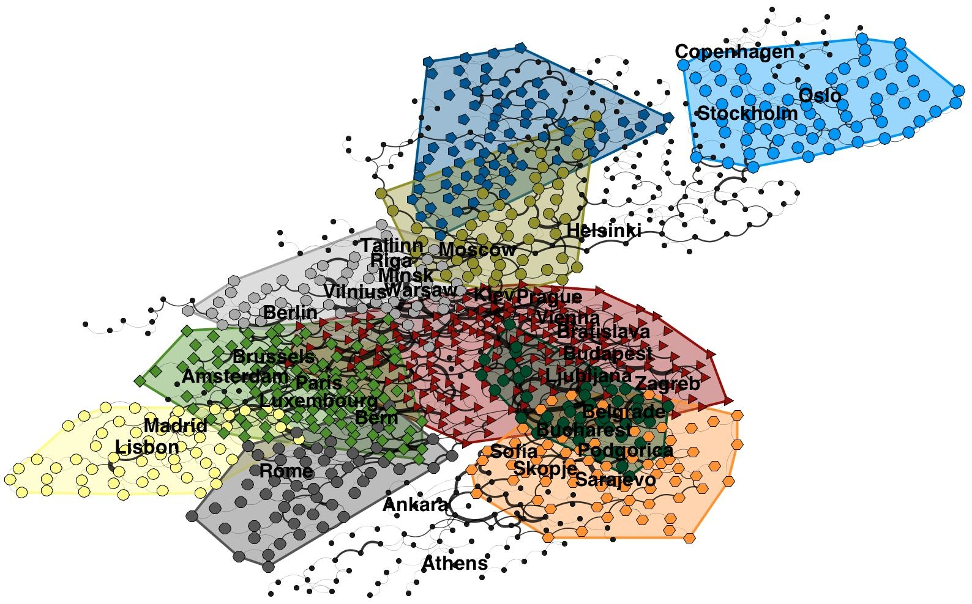
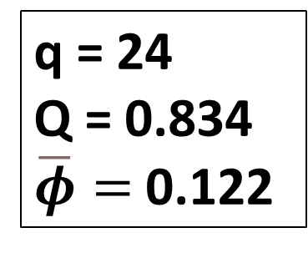

European road network analysis
Andrea Bertogalli, 218342
Community detection – BPA
A problem related with LPA is the fact that the nodes which are labeled at the end of an iteration cannot efficiently propagate their label, as most of their neighbors are already been updated. So, as the labeling order at each iteration is random, the algorithm is quite unstable.
BPA fix this issue by adding an ad-hoc preference term computed as:
$$p_{n}=\frac{index of node n}{|N|} , { p}_{n}∈(0,1]$$
q = 24
Q = 0.834
$\overline{φ}=$0.122
Reference:
Robust network community detection using balanced propagation, L. Šubelj et. Al, 2011 (arxiv.org) [BPA]
Fig.26: 10 top communities computed with BPA.

Slide 22
European road network analysis
Andrea Bertogalli, 218342
Conclusions
The network has no distinctive features except for the community structure. Regarding this we can compare the various algorithms used:
Algorithm | Communities | Modularity | Avg. Conductance
Louvain | 21 | 0.862 | 0.071
Persistance probabilities – sht. Path (α=0.85) | 21 | 0.849 | 0.085
Persistance probabilities – mfpt (α=0.7) | 22 | 0.833 | 0.056
Infomap | 112 | 0.784 | 0.197
LPA | 343 | 0.5617 | 0.442
BPA | 24 | 0.834 | 0.122
Fig.27: Communities detection algorithms comparison.

Slide 23
Thanks for your attention
European road network analysis
Andrea Bertogalli
218342
Accademic year 2022/2023

